Slide 1



Programming in Python

Slide 2
Outline
Day 1: Why program, printing, variables.
Day 2: Data types, input(), arithmetic operations.
Day 3: Conditions, if-elif-else, boolean logic.
Day 4: Loops: while, for, range().
Day 5: Functions and lists.
Day 6: Project review, Python career paths.

Slide 3

Github

Slide 4
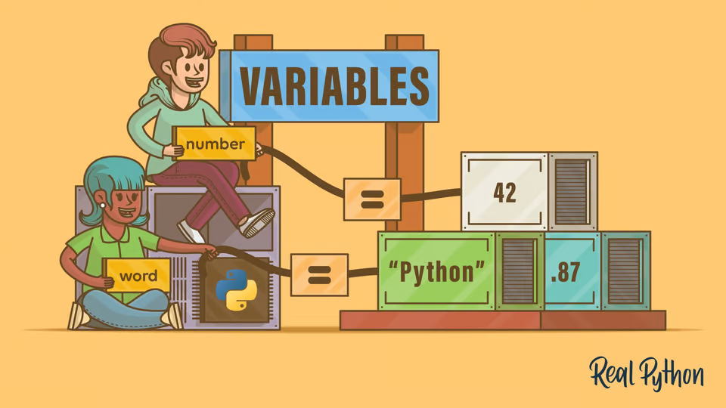
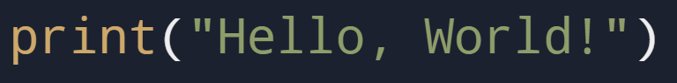
Day 1

Slide 5
Objectives
Why learn programming?
What is Python?
Python “Environment”
Print()
Variables

Slide 6
Benefits of Learning Programming
Improves logical thinking and problem-solving skills.
High demand for skilled programmers in various industries.
Fun and rewarding: Create something meaningful from scratch.

Slide 7
What and Why Python?
Developed by Guido van Rossum in 1991.
General-purpose programming language.
Known for:
Simple and readable syntax.
A large community and extensive libraries.
Popular for:
Web apps, AI/ML, automation, data analysis, etc.

Slide 8



Setting Up Your Python Environment
Notes:
Explain a little about IDE, show an example of writing code in notepad

Slide 9
print()
Notes:
Explain a little about IDE, show an example of writing code in notepad

Slide 10

Task 1: Google Classroom and Printing
Description:
Sign in to the Google Classroom
Write code to print the following sentences:
Free Palestine.
I am EXCITED to learn python.
Write code to print anything you’d like (Be Creative✨)
Submit the code on Google Classroom in Task 1
Notes:
Explain a little about IDE, show an example of writing code in notepad

Slide 11
755ojqu
Notes:
Explain a little about IDE, show an example of writing code in notepad

Slide 12
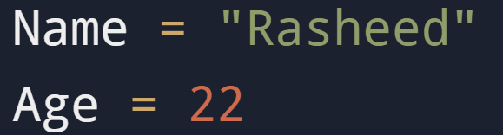
What Are Variables?
Notes:
Explain a little about IDE, show an example of writing code in notepad

Slide 13
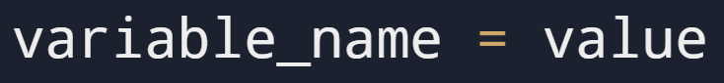
Creating Variables
Rules:
Must start with a letter or underscore (_).
Cannot start with a number.
No spaces or special characters.
Must not be a reserved word.
Notes:
Explain a little about IDE, show an example of writing code in notepad

Slide 14
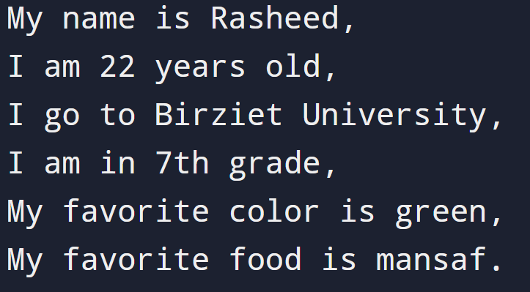
Task 2: Introduce Yourself
Description:
Create a variable for the following:
your name.
your age.
your school.
your class.
your favorite color.
your favorite food.
Use the print function to print them like the Image
Notes:
Explain a little about IDE, show an example of writing code in notepad

Slide 15
Why Are Variables Important?
Storing user input.
Simplifying repetitive tasks.
Keeping track of game scores, calculations, etc.

Slide 16
Summary

Slide 17
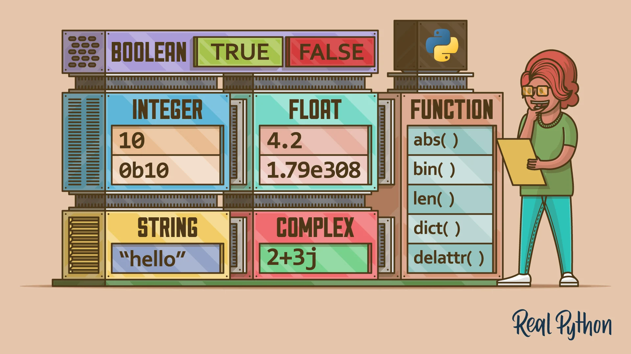
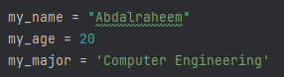
Day 2

Slide 18
Objectives
What are data types ?
How to choose the correct data type
Casting
input()
Arithmetic - (+, -, *, /, etc…)

Slide 19
Data types
Some of most common data types:
Integers
Float
Characters
Strings
Boolean

Slide 20
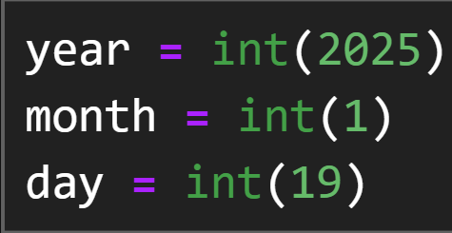
Integers

Slide 21
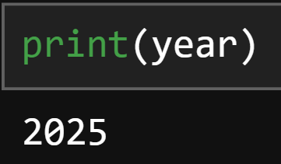
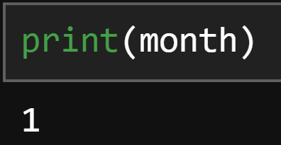
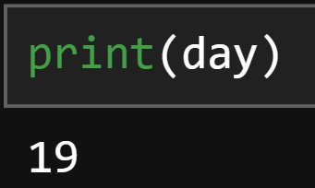
Integers

Slide 22
Integers
Try it yourself! - Write your birthday
year = int(_)
month = int(_)
day = int(_)

Slide 23
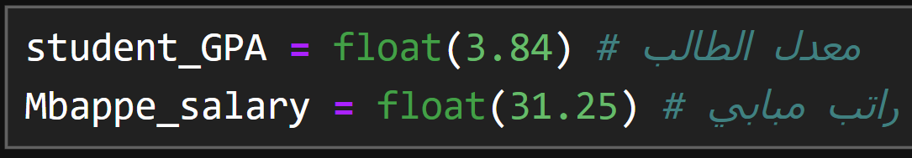
Floats

Slide 24
Integer VS Float
You don’t have to specify the type - مش محتاج تحدد نوع المتغيرات
Python is SMART

Slide 25
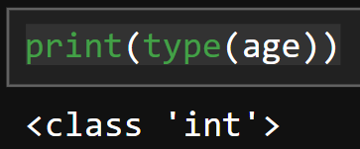
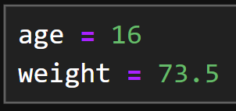
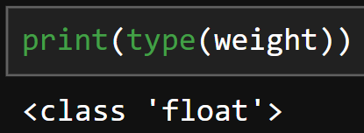
type()

Slide 26
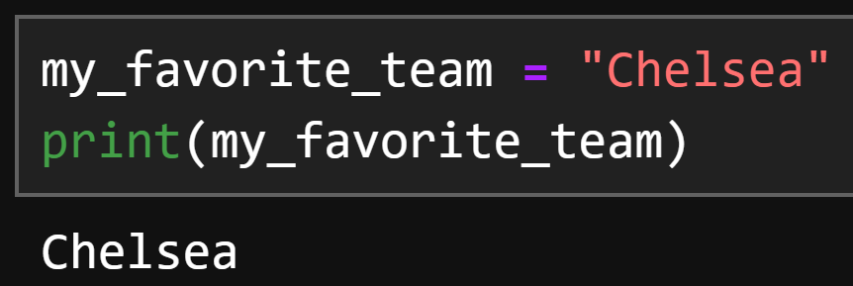
“Strings”

Slide 27
Task 1: Determine the type
Write a code that prints to you the type of the followings - اكتب كود بطبع نوع التالي
TRY TO GUESS IT FIRST - حاول خمن بالاول
Year = 2004
Weight = 120.0
Phone_number = “0599999999”

Slide 28
Casting
Is there a way to convert from Integer to String
or from float to integer?
هل في طريقة احول من نوع بيانات للاخر ؟

Slide 29
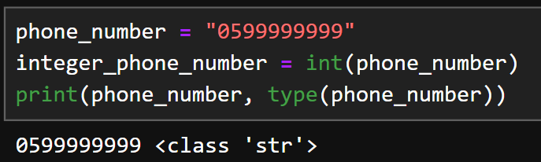
Casting - String to Integer

Slide 30
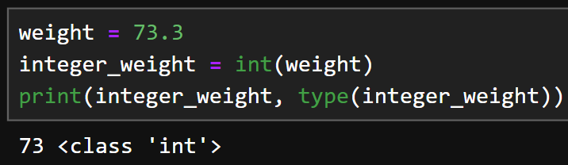
Casting - Float to Integer

Slide 31
input()
How can I read data from the user ?
كيف أقرأ البيانات من المستخدم ؟

Slide 32
input()

Slide 33
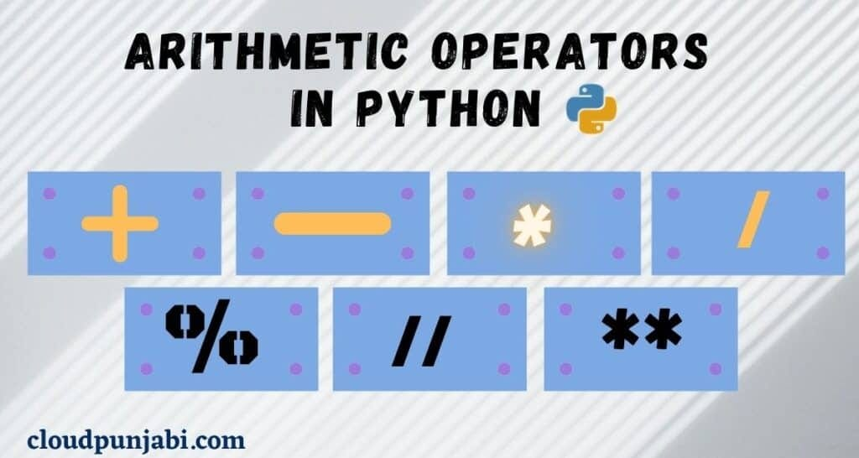
Arithmetic

Slide 34
Arithmetic
Some python operations - بعض العمليات الحسابية في بايثون
+
*
/
**
%

Slide 35
Add and Subtract
ADD +
SUBTRACT -
جمع +
طرح -

Slide 36
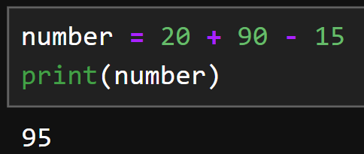
Add and Subtract
Doing calculations through numbers directly
القيام بالعمليات الحسابية مباشرة

Slide 37
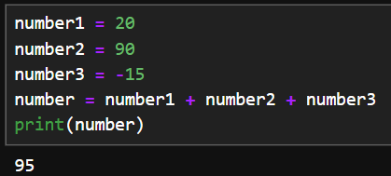
Add and Subtract
Doing the calculations through variables
القيام بالعمليات الحسابية باستخدام متغيرات

Slide 38
Multiply and division
Multiply *
Divide /
ضرب *
قسمة /

Slide 39
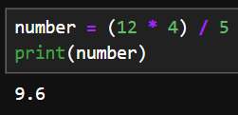
Multiply and division

Slide 40
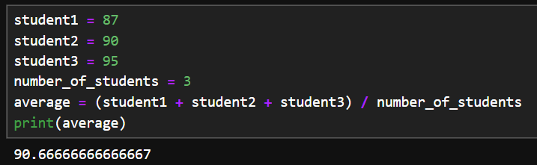
Multiple operations

Slide 41
Power
Power **
القوة **
example)
Number = 6
Square = Number ** 2

Slide 42
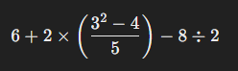
Task 2 - Arithmetics
Write a program that calculate this operation and saves it in variable
Feel free to use many variable as you want

Slide 43
Even and Odd
How to know if a number is even or ODD ?
كيف تعرف اذا الرقم فردي او زوجي ؟

Slide 44
Even and Odd
YES, you can know if a number is even or odd if it’s divisible by “2”,
If the number remaining is 0 then it’s divisible else it’s not
إذا كان الرقم قابل للقسمة على 2 (باقي القسمة على 2 صفر) بكون زوجي, غير هيك فردي

Slide 45
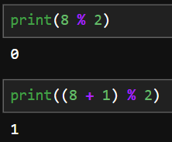
Modules %
You can see that the first number (8) remaining when dividing by 2 is 0
but when adding 1 to it it’s not
ال 8 بتقسم على 2, باقي القسمة صفر
ال 9 ما بتقسم على 2, باقي القسمة مش صفر

Slide 46
HOMEWORK

Slide 47
Homework
Write a program that takes 3 numbers from the user and then calculate their variance
اكتب برنامج بقرأ 3 ارقام من المستخدم بعدين بحسب التشتت

Slide 48
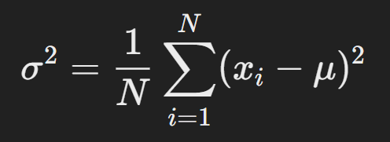
Variance equation
σ: variance - التشتت
N: number of numbers - عدد الارقام
∑: Summation - مجموع
xi​ : each number - كل رقم
μ: Mean or Average - المتوسط

Slide 49
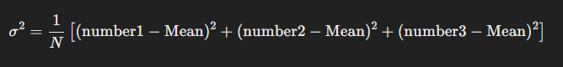
Variance example
Suppose we have three numbers
Note: Mean is the same as average which we measured earlier

Slide 50
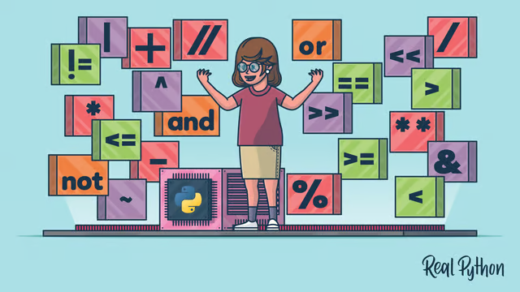
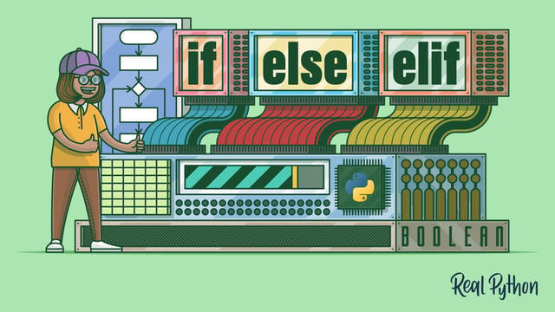
Day 3
Comparison & logical operators, and logical expressions.
If-else statements (conditionals.)

Slide 51
Objectives
Understand how operators are used to form conditions.
Apply comparison operators to compare values.
Combine logical and comparison operators.
Get to know conditionals and their types.
Use logical expressions in conditional statements.

Slide 52
Comparison and Logical Operators
The Building Blocks of Decision-Making
Operators are symbols or keywords that perform operations on values or variables.
We’ll be exploring two types:
Comparison Operators: To compare values or variables, such as: <, >, <=, >=, ==, !=.
Logical Operators: To combine or manipulate conditions, such as: and, or, not.
age > 18
y <= 92
z == y
first_name == "John" and last_name == "Doe"
2 == (2 * x) or 2 != (2 * x)
not age > 18 and age >= 13

Slide 53
Comparison Operators
Operator | Description | Example | Result
== | Equal to | 1 == 1 | True
!= | Not equal to | 2 != 3 | True
< | Less than | 3 < 5 | True
> | Greater than | 7 > 10 | False
<= | Less than or equal to | 3 <= 3 | True
>= | Greater than or equal to | 4 >= 3 | True
x = 10
y = 20
print(x < y) # True
age = 24
is_adult = age > 18
print(is_adult)# True

Slide 54
Logical Operators
Operator | Description | Example | Result
and | True if both conditions are true. False if one of them is false. | True and True | True
 |  | True and False | False
or | True if at least one condition is true. False if both are false. | True or False | True
 |  | False or False | False
not | True if the condition is false. (Inverts the condition) | not False | True
 |  | not True | False
age = 24
is_adult = age > 18
has_license = True
can_drive = is_adult and has_license
print(can_drive) # True

Slide 55
Logical Operators
print(5 < 7 and 3 == 3) # True
print(5 < 7 and 3 != 3) # False
print(5 > 7 and 3 == 3) # False
print(5 > 7 and 3 != 3) # False
print(5 < 7 or 3 == 3) # True
print(5 < 7 or 3 != 3) # True
print(5 > 7 or 3 == 3) # True
print(5 > 7 or 3 != 3) # False
print(not 5 < 7) # False
print(not 5 > 7) # True
print(not 0) # True
print(not 1) # False

Slide 56
Tasks
Create two variables, a and b, and assign them any numbers. Write expressions using (==, >, <, and, or, not).
Assign three numbers to x, y, z. Write an expression to check if x is the largest of the three.

Slide 57
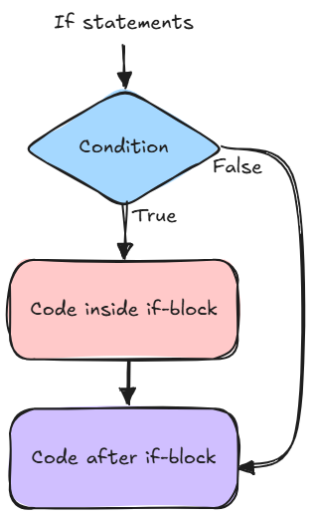
If-else statements (Conditionals)
How Programs Make Decisions
Conditionals are used to perform actions (code) based on whether a condition is True or False.
Conditions: Expressions that equal True or False, consisting of comparison and/or logical operators
Blocks of Code: Code inside the if-statement block, which only runs if the condition is true. Indicated by an indentation at the beginning of each line inside the block (after the condition).

Slide 58
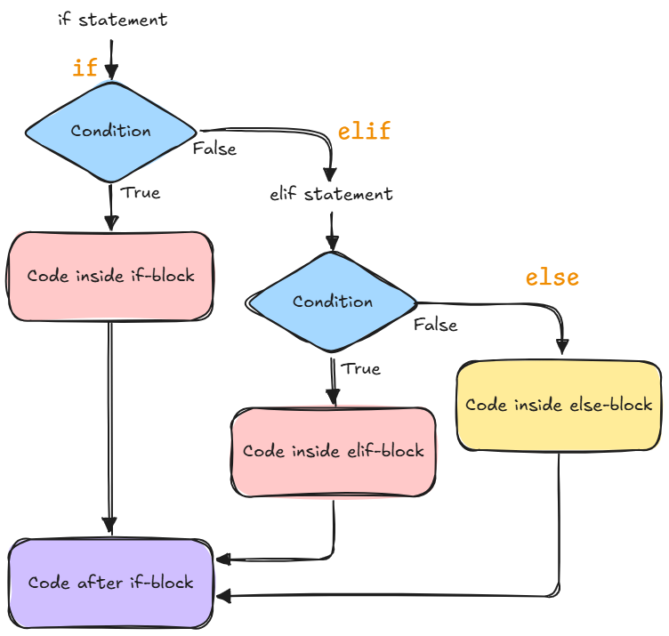
Types of Conditional Statements
There are three types of conditional statements, each serves a certain purpose:
if
if-else
elif

Slide 59
The if Statement
Structure:
Example:
if condition:
# code to execute if the condition is True
age = 18
if age >= 18:
print("You are an adult!")

Slide 60
The if-else Statement
Structure:
Example:
if condition:
# code to execute if the condition is True
else:
# code to execute if the condition is False
temperature = 25
if temperature > 25:
print("It's hot outside.")
else:
print("It's a pleasant day.")

Slide 61
The elif Statement
Structure:
Example:
if condition1:
# code to execute if condition1 is True
elif condition2:
# code to execute if condition2 is True
else:
# code to execute if none of the conditions are True
mark = 85
if mark >= 90:
print("Grade: A")
elif mark >= 75:
print("Grade: B")
else:
print("Grade: C")

Slide 62
Using Logical Operators in Conditionals
The logical operators and expressions we talked about earlier can be used with conditionals to create more complex conditions.
temperature = 27
if temperature > 35:
print("It's REALLY hot! 🥵☀️")
elif temperature > 30:
print("It's hot.")
elif temperature > 20 and temperature <= 30:
print("It's warm.")
elif temperature <= 0:
print("It's freezing! 🥶❄️")
else:
print("It's cold.")

Slide 63
Tasks
Ask the user to input a number. Print whether it’s positive, negative, or zero. And print whether it’s even or odd. remember: x % 2 returns 0 if x is divisible by 2 (even).
Ask the user to input their marks. Print the grade based on the following:
Grade A: marks greater than 90.
Grade B: marks less than 90 and greater than or equal to 75.
Grade C: marks less than 75 and greater than or equal to 50.
Grade F: marks less than 50.

Slide 64
HOMEWORK

Slide 65
Homework
Create a simple quiz program. Think of three questions to ask the user (for example: 4 * 7, capital of a country, name of a song, etc.)
Take input from the user for each question, and store the answer in a variable.
Use if/if-else/elif statements to check the answers (in case a question can have multiple correct answers).
Keep a score and print it after the quiz is done.
Feel free to print whatever you want based on the user’s score. (You can also use conditionals to print different results if the user got 3/3, 2/3, 1/3, or 0/3 score).
Hint: Create a variable score at the beginning and assign it to 0. And inside each correct block, add 1 to it.

Slide 66
Day 4

